Slide 1
INFO 250 Information Visualization
Week 2A: Ontologies of visualization
Classification of Visualization (I)
Classification of Data types
Demonstration of RAW

Slide 2
Summary of last week
We talked about definition and some other basic concepts about information visualization.
What is information visualization?
What makes a good visualization?
We saw some fancy visualizations, but you should also learn from bad or very simple examples. (An example: https://www.economist.com/graphic-detail/2019/09/24/americas-economics-profession-still-has-a-problem-with-diversity /)

Slide 3
Project of this week
Due: 11:59PM of Oct 3 (Sunday 11:59 PM)
Goal: You will use RAW (http://app.rawgraphs.io/) to start exploring different visualization types.
Tasks:
Choose one of the datasets from the "Try our samples" tag. For your chosen dataset, generate 4 types of visualizations with RAW out of the 21 options. (3 points)
For each type of visualizations, analyze them, and observe (1) how many visual patterns it supports; (2) for each visual pattern, does the visualization support specific type of data; (3) what general relationship between data points can a reader get from the graph; (4) how would you compare the pros and cons of each graph? Summarize your findings in a table. (5 points)
For this dataset, recommend the best visualization option based on your findings in step #2. Justify your recommendation with what we have talked about in this course or your personal insights into visualization. (2 points)

Slide 4
Overview of this class
In the following two weeks, we will talk about classification of visualization. In this class specifically, we will talk about the classification by (1) data type and (2) complexity and how that is related to the dataset that you are working on.
We will also discuss some principles and pitfalls in the designing of some common visualization types.
This topic is important for two reasons:
It is a basic element to take into consideration during the design of visualization.
It is important because you need to learn to speak the language before becoming a professional.

Slide 5
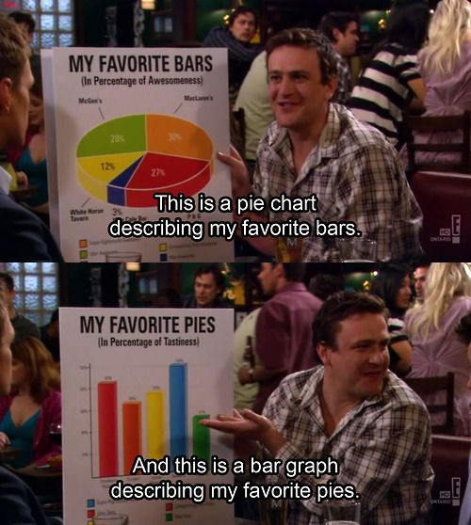

Slide 6
How to classify information visualization?
There are countless of ways of classifying information visualization.
Data type
Complexity
Function
Media
Problem
…

Slide 7
Classification by data type and complexity
Both types of classification are useful analytics tools for you to determine what visualization types can be used to represent a specific dataset.
What underlies these tools is the idea that the overall visualization design should match with the complexity of data and that individual visual pattern should match with the type of specific data variable.

Slide 8
Basic types of data value
We are not going to talk about higher-level data types, such as lists, tuples, data frames, vectors, et al., because they are the types of “data containers”. Instead, we are just going to talk about the type of data values.
In R, data values can have the following major types:
Character: “ABC” or “def”
Numeric or Integer: “2” or “2L”
Logical: TRUE or FALSE
(Datetime): “2019-07-02”
(Factor): “Red”, “Blue”, “Yellow”
Notes:
Categorical

Slide 9
Types of numbers
Nominal
Named
Examples include the zip code: “19104”
Ordinal
Named + ordered
Examples include the ranking: 1st, 2^{nd…}
Interval
Named + ordered + proportional interval
Examples include temperature or GRE scores
Ratio
Named + ordered + proportional interval + absolute zero
Examples include weight and height, in which zero means “do not exist.”

Slide 10
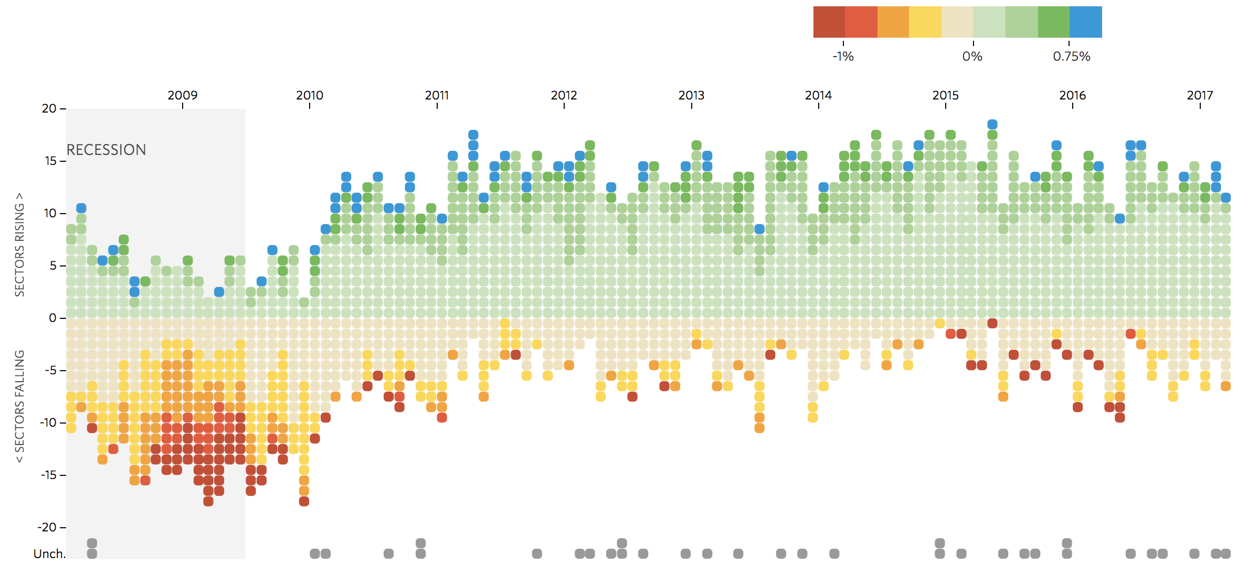
How many visual patterns are used in this graph? And what data type does each pattern represent?
http://graphics.wsj.com/job-market-tracker/

Slide 11
Analysis of the graph
X-axis: Year (Datetime)
Y-axis: Rising or falling (Categorical)
Color: The extent to which one market changes in a given year (Categorical) *
Order of the y-axis: The order based on the amount of change of a market in a given year (Ordinal)
(Invisible or not from the data depending on the algorithm): The amount of change of a market in a given year (Ratio)

Slide 12
Complexity of visualizations
One-dimensional:
Two-dimensional:
Three-dimensional:
Temporal:
Tree/Hierarchical:
Network

Slide 13
Complexity of data
The classification of visualization by complexity largely corresponds to how datasets are classified by their complexities, such as the scheme proposed by Ben Shneiderman (2003):
1-dimensional
2-dimensional
3-dimensional
Temporal:
Multi-dimensional
Tree
Network
https://drum.lib.umd.edu/bitstream/handle/1903/5784/TR_96-%C3%82%C2%AD%C3%A2%20%2066.pdf.?sequence=1

Slide 14
Dimensions of data vs. visualization (I)
The numbers of dimensions of data and visualization must be matched to be meaningful.
Sometimes, we can represent the same dimension of data as different visual patterns in the same graph. But this practice creates repetitive information in the graph and should be avoided unless there is any good reason.
Tufte’s Principle of Graphical Integrity #5

Slide 15
1- to 3-dimensional data
ID | Name | Width | Height | Weight | Value
1 | ABC | 100 | 100 | 103 | 100
2 | DEF | 105 | 95 | 97 | 90
1D
2D
3D

Slide 16
Temporal data
Year | Population (Million) | +-%
2010 | 19.38 | 2.1%
2000 | 18.98 | 5.5%
1990 | 17.99 | 2.5%
1980 | 17.56 | -3.7%
1970 | 18.24 | -

Slide 17
Tree or structured data
ID | Country | State | Population
1 | US | New York City | 8.62
2 | US | Philadelphia | 1.58
3 | US | Chicago | 2.71
4 | US | Boston | 0.68
5 | China | Beijing | 21.54
6 | China | Shanghai | 26.32
7 | Japan | Tokyo | 9.27
8 | Japan | Osaka | 2.9

Slide 18
Network data
From | To | Weight
1 | 2 | 2
1 | 3 | 4
1 | 4 | 1
2 | 3 | 1
2 | 4 | 2
2 | 1 | 1
3 | 4 | 6
Notes:
“edge”

Slide 19
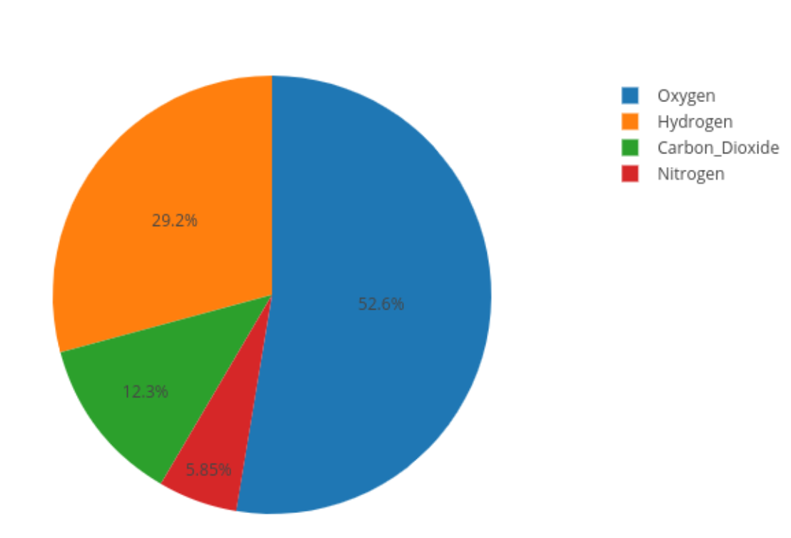
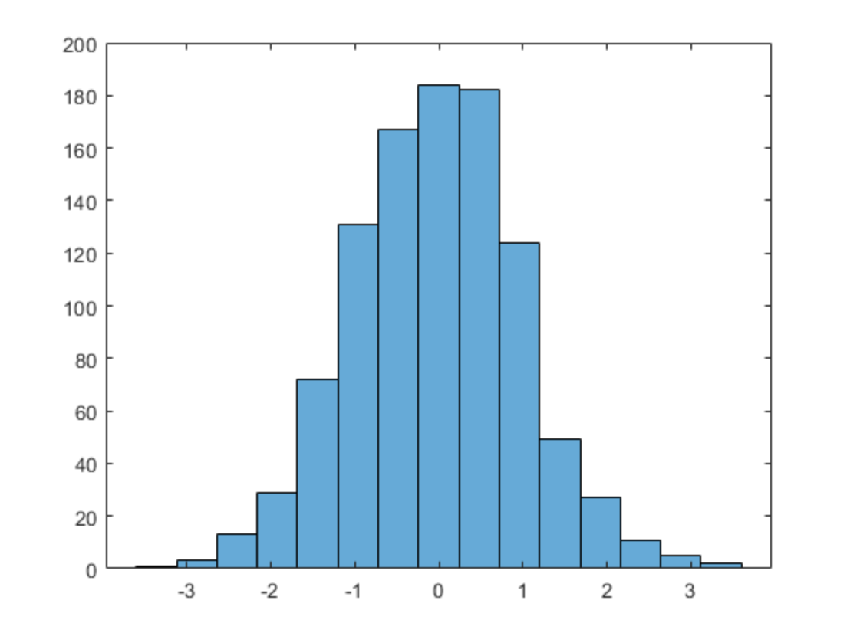
One-dimensional Visualization
You should not expect to see a lot of one-dimensional visualizations.
It can only show one visual pattern, so it is normally too simple.
But in a way, you can imagine simple pie chart, simple bar chart, babble chart, and histogram as one-dimensional.

Slide 20
Two-dimensional Visualization
Many common visualization types you can see are two-dimensional, i.e., visualization presenting two independent (in the sense that they do not have hierarchical relationship) variables.
It is normally enough to tell a sophisticated enough story.
And it fits into a printed metaphor of graphic design.
Some examples include scatterplot, area chart, line chart.
All of these visualization types are presented in a two-dimensional space.
Maps can also be seen as a two-dimensional visualization.

Slide 21
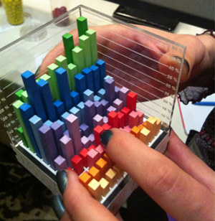
Three-dimensional Visualization
If two-dimensional visualization fits into the printed metaphor, three-dimensional visualizations do not do it so well!
We are not going to talk about this visualization type very much.
https://aviz.fr/phys

Slide 22
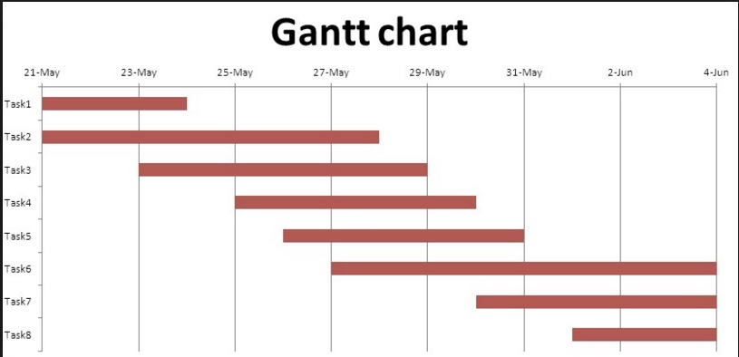
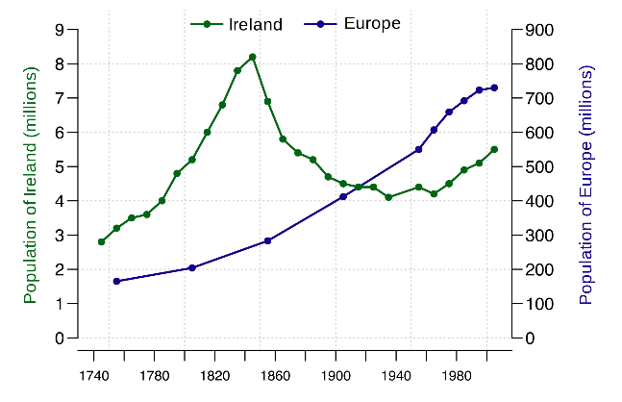
Temporal visualization
Temporal data variable can be regarded as a normal type of data point.
Some common graph types for temporal data include: Gantt Chart, line chart, area chart.
For normal two-dimensional graph, temporal data is normally represented in the x-axis.

Slide 23
Let’s move to RAW
http://app.rawgraphs.io/

Slide 24
For next class
You can start working on this week’s project.
The last 15 minutes of the next class will be used as the lab/networking time. You can spend the time working on the assignment or ask any question you may have about this assignment or network with your classmates.

